Slide 1
PRINCIPLES OF MANAGEMENT
Dr.R.Prabhu

Slide 2
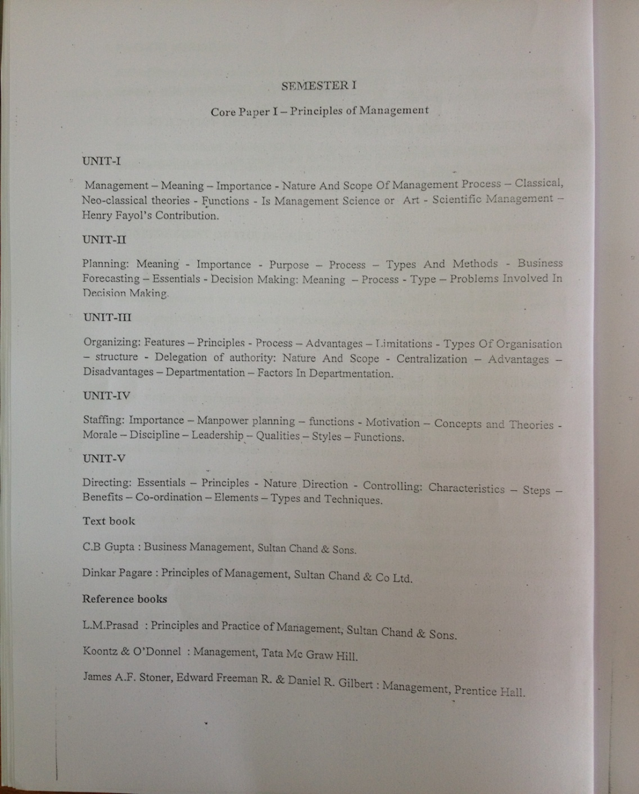

Slide 3
Company
Write down the names of 10 Indian companies that you know
Write down the names of 10 International companies that you know

Slide 4
Manager
What does a Manager do at his office?

Slide 5
Definition of Management
F.W.Taylor’s definition – “Management is knowing exctly what you want men to do and then seeing that they do it in the best and efficient way”
Louis Allen’s definition – “Management is what a manager does”
Koontz & O’Donnell’s definition – “Management is the creation and maintenance of an internal environment in an enterprise where individuals working together in groups, can perform efficiently and effectively towards the attainment of group goals”

Slide 6
Scope of Management
Two aspects are there in Scope of Management
Subject matter of Management and
Functional areas of Management

Slide 7
Subject matter of Management
This includes the various functions of Management like
Planning
Organising
Staffing
Directing and
Controlling

Slide 8
Functional areas of Management
This consists of the following areas
Financial Management
Personnel management
Production management
Office Management
Marketing Management
Maintenance Management

Slide 9
MANAGEMENT PROCESS
This is a process of activities which can be divided into four distinct integrated activities
Planning : Deciding what is to be done
Organising : Deciding how it is to be done and who will do it
Leading : Influencing Behaviour
Controlling : To make sure that plans are carried out

Slide 10
Characteristics of Management
Management is a process
Management is purpose oriented
Management is goal oriented
Management is a dynamic process
Management is multi-discilplinary
Management as a disclipline
Management is all pervasive
Management is an influence process

Slide 11
MANGEMENT AS AN ART OR SCIENCE
SCIENCE | ART
1.Advances by knowledge 2.Proofs 3.Predicts 4.Defines 5.Measures 6.Interests | 1.Advances by practices 2.Feels 3.Guesses 4.Describes 5.Opinions 6.Expresses

Slide 12
Levels of Management
Top level
Middle level
Lower level

Slide 13
LEVELS OF MANAGEMENT
TOP LEVEL
MIDDLE LEVEL
LOWER LEVEL
ADMINISTRTION
MANAGEMENT

Slide 14
Roles of a Manager
Henry Mintzberg three roles of managers
1. Interpersonal Role
  A. Figure head
  B. Leader
  C. liaison
  2. Informational Role
  A. Monitor
  B. Disseminator
  C. Spokesperson
  3. Decisional Role
  A. Entrepreneur Role
  B. Disturbance handler
  C. Resource Allocator
  D. Negotiator

Slide 15
Classical Management theories
These theories emerged in the early years of the century (1900-1930)
Classical management consists of two distinct branches
Scientific management and
Administrative management theory

Slide 16
Features of classical management
It is closely associated with the industrial revolution and development of large scale industries which demanded the development of new forms of organisation and management.
It is based on scientific, administrative and bureaucratic model.
Management thought focused on productivity, job content, structure, standardization, simplification and specialization.
Scientific approach towards organization and management.

Slide 17
TAYLOR AND SCIENTIFIC MANAGEMENT
Fredrick Taylor defined the basic problem of managing as the art of knowing exactly what you want one to do and see that they do it in the best and cheapest way.
Taylor joined Midvale Steel company as a worker and later became supervisor. Here he completed ME and joineed Bethlehem Steel company. In both these places he carried on experiments on how to increase the efficiency of people.
Taylors contributions can be described in two parts
Main features of scientific management and
Principles of scientific management

Slide 18
1. Main features of Scientific Management
Separation – of planning and doing. Planning should be done by superiors and operational work by workers
Functional Foremanship – This is against the unity of command as a lot of planning incharge people and production incharge people give orders to one worker
Job Analysis – It was done to find out one best way of doing things. This is determined by
a. Time Study and
b. Motion Study.
Standardisation – Should be maintained in respect of instruments and tools, period of work, amount of work, working conditions and cost of production.

Slide 19
5. Scientific selection and training of people – Education, work experience, aptitude, physical strength etc of people to be considered while selection.
6. Financial incentives
7. Mental Revolution – mental co-operatio between management and workers should exist for this and there must be a mental change in both parties
8. Economy – Adequate consideration to be given to the economy and profit while planning

Slide 20
2.Principles of Scientific Management
Replacing the rule of the thumb with science
Harmony in group action
Co-operation
Maximum output
Development of workers

Slide 21
CONTRIBUTIONS OF HENRY FAYOL
Fayol was the first one to divide activities into five groups
Technical – Relating to production
Commercial – Buying, selling and exchange
Financial – Search for capital and optimum use
Accounting – Including statistics
Security – Protection of property and persons
Managerial – planning, organizing, commanding, co-ordination and control.

Slide 22
GENERAL PRINCIPLES OF MANAGEMENT
The 14 principles of management given by Henry Fayol are
Division of work and specialisation
Authority and Responsibility
Discipline
Unity of command
Unity of direction
Subordination of individual to general principles
Remuneration of personnel
Centralization
Scalar chain
Order
Equity
Stability of tenure
Initiative and
Espirit-de-corps

Slide 23
UNIT – II
PLANNING
Definition
Planning may be broadly defined as
“A concept of executive action that embodies the skills of anticipating, influencing and controlling the nature and direction of change”.

Slide 24
Features of Planning
Planning is a process rather than a behavior at a given point of time.
Planning is primarily looking into the future
Planning involves a selection of a stable course of action
Planning is undertaken at all levels in the organization
Planning is flexible as conditions are dynamic
Planning is a pervasive and continuous management function

Slide 25
Importance of Planning
Primacy of planning –
Planning precedes all other managerial functions

Slide 26
what kind or organisation structure
which helps to know
PLANS what kind of people are required
objectives
& how to which affects the kind of direction
achieve
them how effectively to lead people
in order to ensure success of plans
by furnishing standards of control

Slide 27
2. To offset uncertainty and change – There is a continuous change in the environment and the organization has to work in accelerating change
3. To focus attention on objectives – Planning focuses on organizational objectives and direction of action for achieving these objectives
4. To help in co-ordination – Co-ordination is the essence of management and planning is the basis for it
5. Help in control
6. To increase in organizational effectiveness

Slide 28
Types of Plans
PURPOSE OR MISSION
OBJECTIVES
STRATEGIES
POLICIES
RULES AND PROCEDURES
PROGRAMS OR PROJECT
BUDJETS

Slide 29
Characteristics of Planning
It should be based on facts
Stability
Flexibility
Updated procedures
Minimum procedures
Process as a system

Slide 30
Planning process
The following are the important steps in the planning process
To identify the need of planning
Analysis of existing internal profile of organisation
To scan the environment
To prepare statement of objectives
To develop alternative course of action
To evaluate alternative course
Formulation of derivative plans

Slide 31
Advantages of planning
Focuses attention on objectives
Reduces uncertainty
Ensures economical operations
Facilitates control
Improves motivation
Improves competitive strength
Encourages innovation & creativity
Achieves better co-ordination

Slide 32
Limitations of planning
1.Difficulty of accurate premising
2. Problems of rapid change
3. Internal inflexibility
  a. Psychological inflexibility
  b. Policy and procedural inflexibility
  c. Capital investment
  4. External inflexibility
  a. Political climate
  b. Trade unions
  c. Technological changes
  5. Time and cost factors
  6. Failure of people in planning

Slide 33
Business forecasting and essentials
Forecasting is assumptions or forecast of the future and known conditions that will affect the operation of plans.
Some sales forecasting methods are
Jury of executive opinion method
Sales forecast composite method
Users expectation method
Statistical methods
a. Trend and cycles
b. Correlation analysis
c. Mathematical formulas or models

Slide 34
Decision Making
Decision making is both managerial function and organizational process
Discuss importance of decision making

Slide 35
Definition of Decision Making
According to GeorgeTerry
“Decision Making is the selection based on some
criteria from two or more alternatives”

Slide 36
Steps in the decision Making Process
The following are the important steps in the Decision making Process
Identification of a Problem
Collect and Analyze the relevant information
Find out alternative course of Action
Implementing and Verification of the Decision
Evaluating the Alternative course of Action

Slide 37
Types of Decision Making
The following are the major types of Decisions made by managers
1. Programmed and Non-programmed decisions
2. Major and minor decisions
Routine and Strategic decisions
Individual and Group decisions

Slide 38
Problems involved in Decision Making
The common problems in making and implementing the decisions are as follows
Incomplete information
The accuracy and reliability of information
Un-supporting management environment
Non acceptance of subordinates
Ineffective communication
Incorrect timing
Lack of organizational commitment
Bias in decision making

